Slide 1
Arrays & subroutines

Slide 2
Arrays
myInt
Simple integer variable
int myInt;
myInt = 5;
Array
int[] myArray ;
myArray = new int[5];
myArray[0]=5;
myArray[1]=6;
myArray[2]=47;
myArray[3]=444;
myArray[4]=11;
5
myArray
0
5
1
6
2
47
3
444
4
11

Slide 3
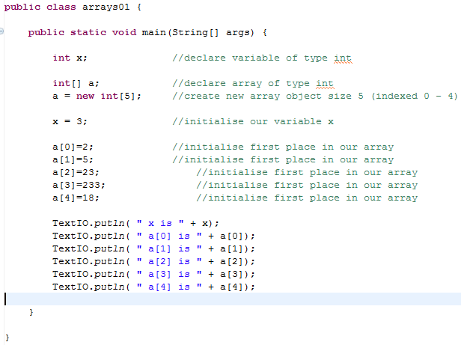
See next for larger code

Slide 4
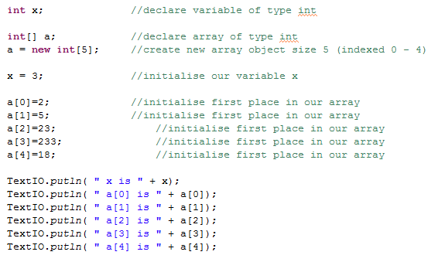

Slide 5
Arrays and Loops
Which part is the repeating part?
How can you put it into a loop?

Slide 6

Arrays and Loops

Slide 7
Subroutines

Slide 8
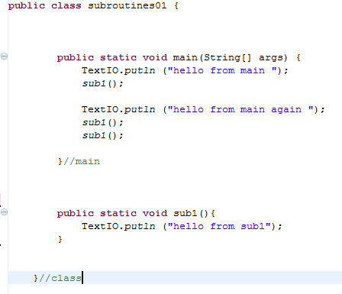
void

Slide 9
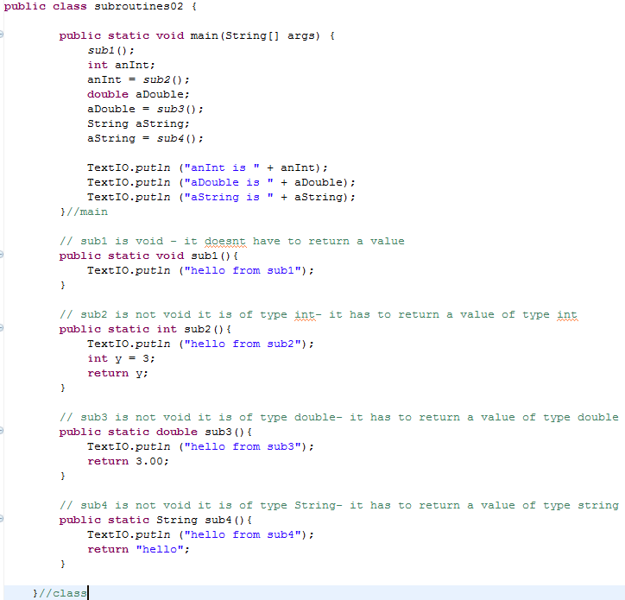
Subroutines with a return Type
See next for larger code

Slide 11
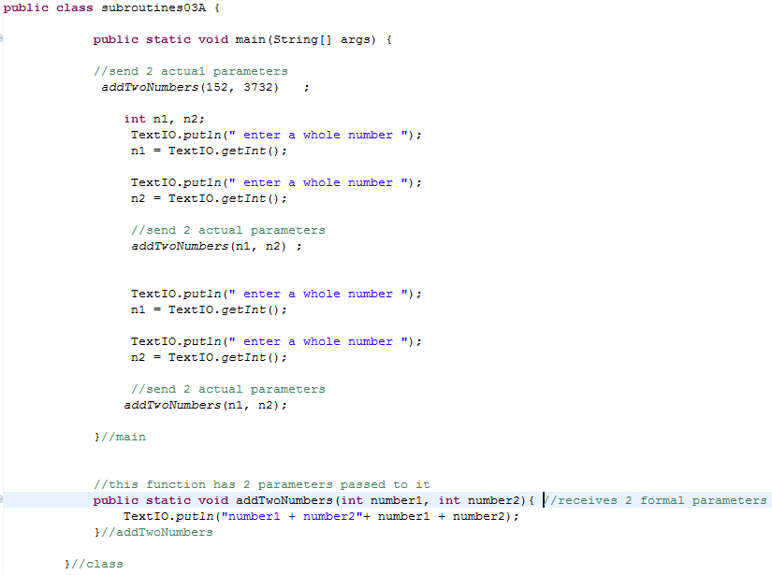
Passing parameters
See next for larger code

Slide 13
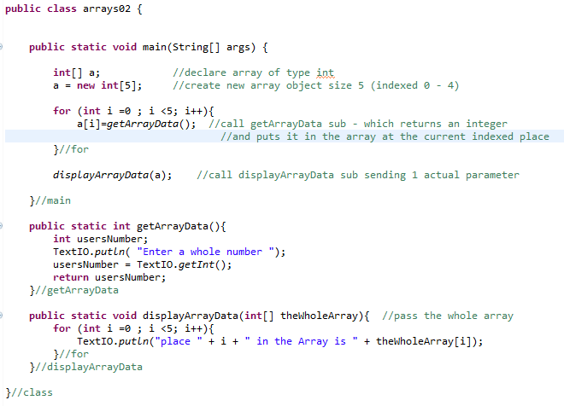
Passing Arrays as parameters

Slide 15
Tasks
Write a program that
Asks the user for 4 names and stores them in an array
Displays the contents of the array
Write a program that
Has two subroutines
One to display a line of text
One to display the 8 times table
(these can be void and you don’t have to pass parameters)
Write a program that
Has two subroutines
One to add 3 numbers
One to calculate the average of 3 numbers

